Slide 1
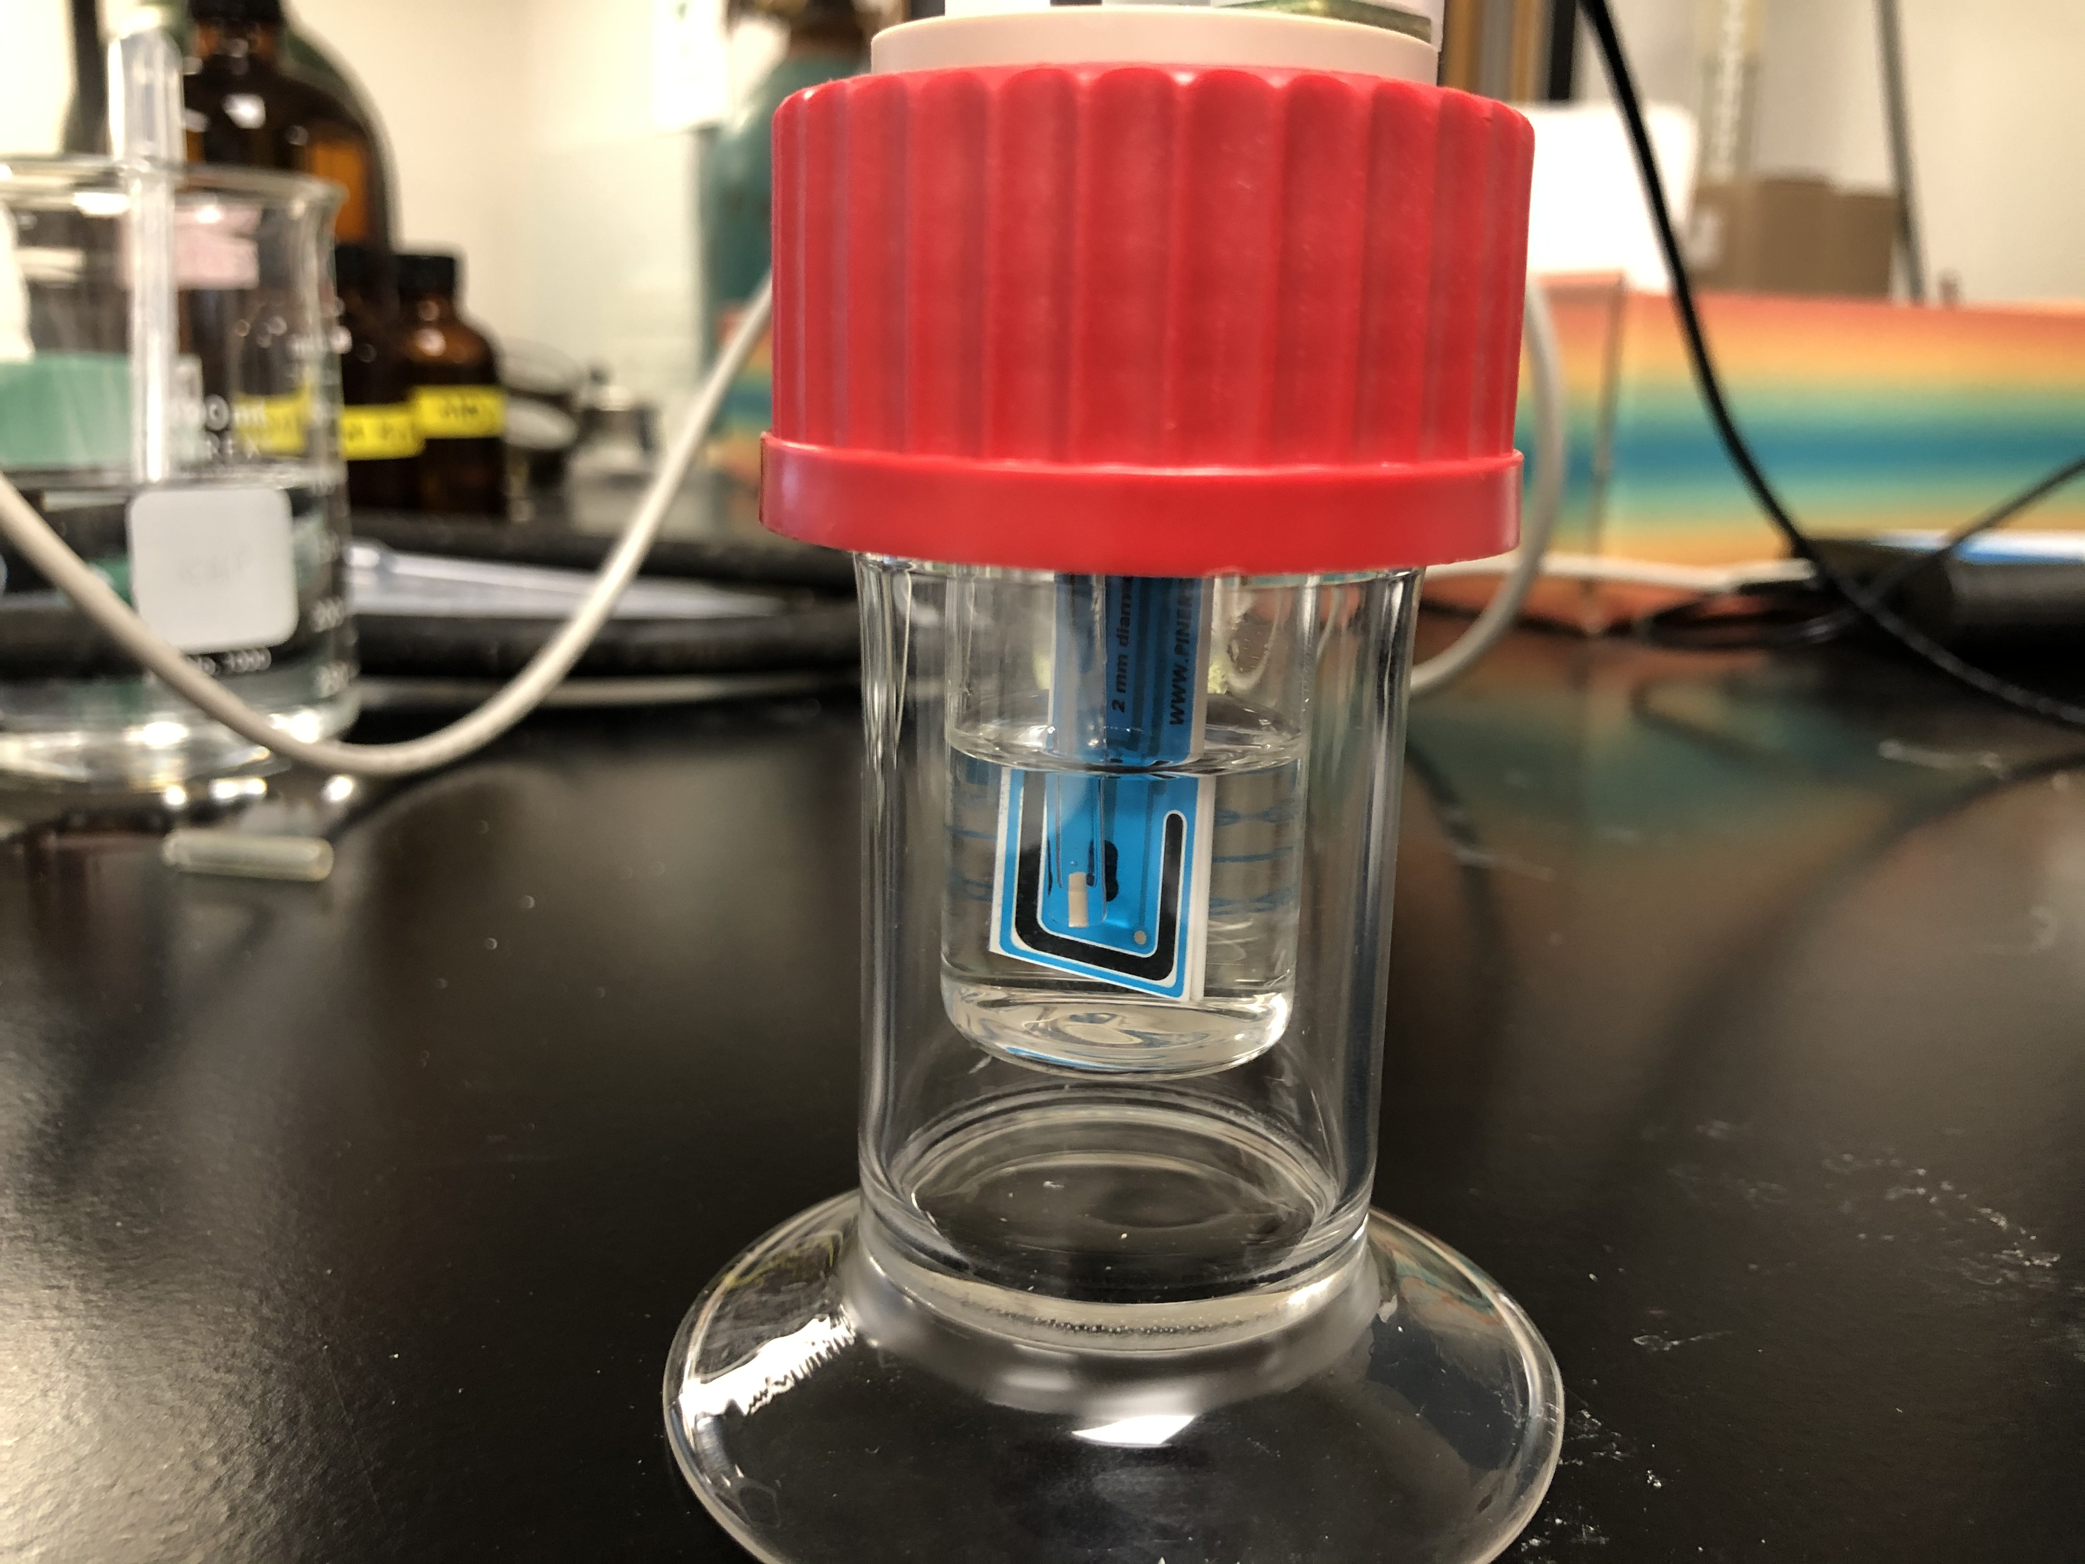
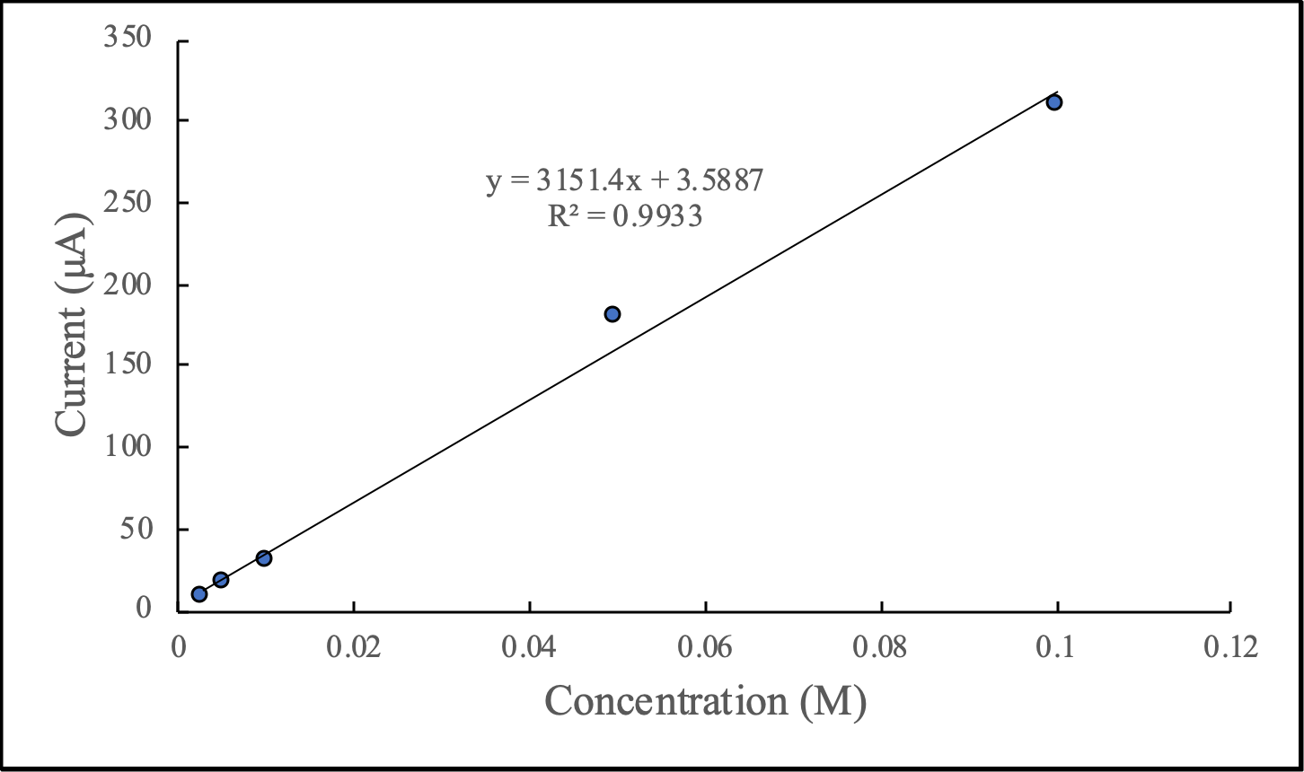
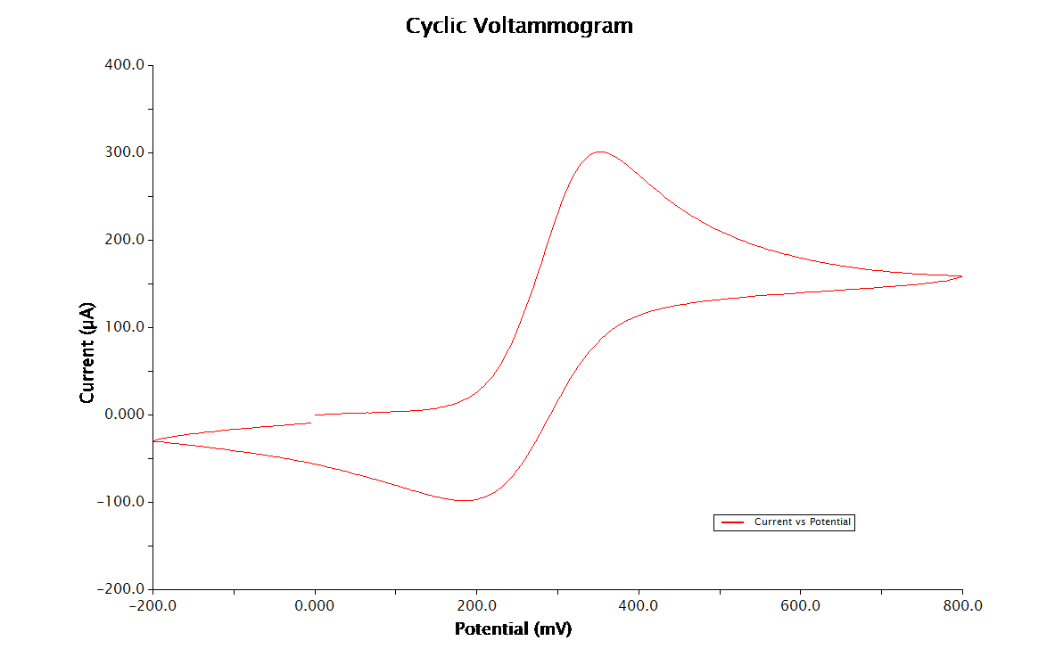
Developing an Experiment for General Chemistry II
Tyler Fisher, Nuvia Saucedo, Ph.D.
Hickman Science Center, Southern Adventist University, Collegedale, TN 37315
Introduction
Cyclic Voltammetry is a popular technique used by chemists to investigate reduction and oxidation processes of different species¹. Cyclic Voltammetry (CV) is performed by cycling the potential of a working electrode and measuring the resulting current¹. This method of scientific investigation is very versatile. Not only can a scientist run a reduction or oxidation reaction, but since the process involves electron transfer, the whole process can be monitored and mapped out. This method works with organics and inorganics, polymers, liquids, and solids². Despite the growing popularity of cyclic voltammetry, many students do not receive formal training in this technique in their undergrad experience³. In using cyclic voltammetry, the Chemistry Department at Southern Adventist University can effectively teach their students how to interpret redox reactions as well as help them gain more experience with instrumentation earlier in their collegiate career.
Results and Discussion
Figure 3 shows the calibration curve based off the K₄Fe(CN)₆ solution. Through accurate completion of the General Chemistry II experiment, students will obtain a similar graph. Through running this experiment, students will successfully learn how to use cyclic voltammetry. They will gain a greater understanding of redox reactions, potentials, and calibration curves. Future work could include running more compounds through the CV to obtain similar graphs as well as comparing the different potentials of different transition metals.
Methods
The first step in designing the experiment was to determine how the electrochem station can be used for cyclic voltammetry. The electrochem station from Pine Research has many different functions. For the purpose of this research, cyclic voltammetry was the only technique that was investigated. The Wave Now Instrument was plugged in to the computer via a USB and the large cell where the experiment was run was plugged into the Wave Now Instrument. The Ag/AgCl reference electrode was placed in the large cell as well as the blue (carbon), working electrode and the platinum electrode. The solution used for the redox reaction was 10 mL of differing molarities of K₄Fe(CN)₆ in 1.0 M KNO₃. This solution is used to show the oxidation and reduction between Fe³⁺ and Fe²⁺. For the experiment in General Chemistry II, the students will use 0.1 M CuSO₄ in 1.0 M KNO₃. In this case, Copper will be oxidized and reduced. Five solutions of different molarities were made up and run through the CV experiment. A calibration curve was then obtained (Figure 3) to show the relationship between concentration and current.
Figure 1. Setup for CV Experiment. Blue electrode and Ag/AgCl electrode are shown.
Figure 3. Graph of Current vs Concentration for K₄Fe(CN)₆
References
Libretexts. Cyclic Voltammetry. https://chem.libretexts.org/Bookshelves/Analytical_Chemistry/Supplemental_Modules_(Analytical_Chemistry)/Instrumental_Analysis/Cyclic_Voltammetry (accessed Mar 25, 2021).
Cyclic voltammetry. https://pubs.acs.org/doi/abs/10.1021/ed060p702?casa_token=RaDePEaFZdAAAAAA%3ALstZd1M__SpNwBdwtu2GLwQgZWKr2GmhQ6Lz_Q9m5p1GYjNKIbBW6pxH31INzmGDtZi8FliO3GGkleD42w (accessed Mar 25, 2021).
Elgrishi, N., Rountree, K., McCarthy, B., Rountree, E., Eisenhart, T., & Dempsey, J. (2018). A Practical Beginner’s Guide to Cyclic Voltammetry. Journal of Chemical Education, 95(2), 197–206. https://doi.org/10.1021/acs.jchemed.7b00361
0.1 M K₄Fe(CN)₆
Figure 2. CV graph for 0.1 M K₄Fe(CN)_{6.}

