Slide 1
Osteoporosis
By: Diana Alvarez

Slide 2
Introduction
Definition of Osteoporosis
“. . . a bone disease when the body loses too much bone, makes too little bone, or both” (National Osteoporosis Foundation).
Results
”. . .bones become weak and may break from a fall or, in serious cases, from sneezing or minor bumps” (National Osteoporosis Foundation).

Slide 3
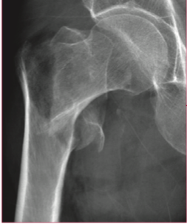
Introduction cont.
Common bone fractures occur in the wrist, vertebrae or hip (Rachner et al., 2011).
Figure 1.1. A fragility fracture of the hip. Adapted from Rachner et al. (2011).

Slide 4
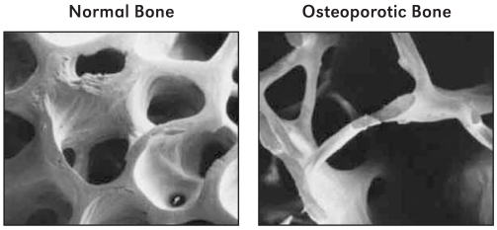
Discussion
General effect
Decreased bone mass and alterations to structure of bone consequently making the affected individual more likely to break a bone (Ross et al., 2020).
Figure 1.2. The left image shows photomicrograph shows what normal bone looks like compared to what osteoporotic bone looks like found on the right photomicrograph. Adapted from Office of the Surgeon General 2004.

Slide 5
Discussion cont.
Cellular Level
Unequal activity of bone cells: osteoblasts and osteoclasts
Osteoblasts build new bone
Osteoclasts break down old bone
In osteoporosis, the activity of the osteoclasts is greater than the activity of osteoblasts

Slide 6
Discussion Cont.
Two types of Osteoporosis (Ross et al., 2020)
Type I primary osteoporosis is seen in women after menopause has begun.
Usually present with greater long-term effect because it starts earlier in life compared to the other type.
Type II primary osteoporosis is more often seen in the elderly, and it is characterized as one of the causes of loss of function in people of this age.

Slide 7
Conclusion
Osteoporosis is a serious disease that affects about 75 million people in America (Ross et al., 2020).
Caused by the activity of osteoclasts being greater than the activity of osteoblasts.
Results in the loss of bone density and alteration to structure of bone leading to bone fragility and fractures.

Slide 8
Literature cited
National Osteoporosis Foundation. (n.d). What is osteoporosis and what causes it? https://www.nof.org/patients/what-is-osteoporosis/.
Office of the Surgeon General (US). Bone Health and Osteoporosis: A Report of the Surgeon General. Rockville (MD): Office of the Surgeon General (US); (2004). Figure 2-5, Normal vs. Osteoporotic Bone. Available from: https://www.ncbi.nlm.nih.gov/books/NBK45504/figure/ch2.f5/
Rachner, T. D., Khosla, S., & Hofbauer, L. C. (2011). Osteoporosis: now and the future. The Lancet, 377(9773), 1276-1287.
Ross, M. H., Kaye, G. I., & Pawlina, W. (2020). Histology: A text and atlas. Philadelphia, Pa: Lippincott Williams & Wilkins.

