Slide 1
Coronary heart disease
Judy Ornelas
Professor Norskov
Southern Adventist University Collegedale, TN

Slide 2
What it is
Coronary Heart Disease, is a plaque buildup within the coronary arteries, in which, the heart can’t deliver enough oxygenated-blood to the body.
In the United States this is the leading cause of death.

Slide 3
What Causes it
The main cause for Coronary Heart Disease is Atherosclerosis.
When an artery becomes damaged by unhealthy lifestyles, cholesterol will start building-up in the site of the damage.
Eventually, the site of the damaged artery will have a build up of cholesterol, calcium, and macrophages.
This plaque build-up, blocks blood flow, depending the size of the plaque build-up.

Slide 4
Histopathology
Normal Coronary Artery
Coronary Artery with plaque build-up

Slide 5
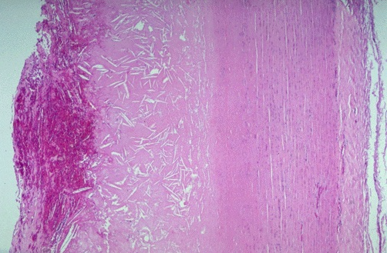
Closer look
Layers of the artery
Tunica Intima
Tunica Media
Tunica Adventitia
Cholesterol Slits
Macrophages
Calcium

Slide 6
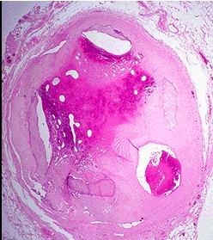
Occlusion of Arteries

Slide 7
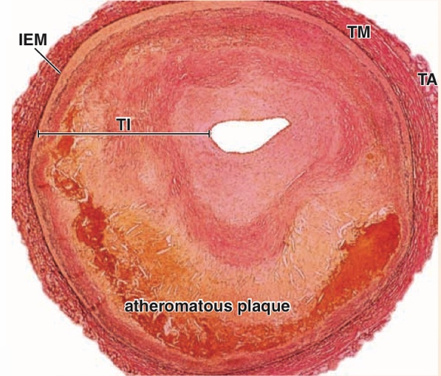
conclusion
Coronary Heart Disease supersedes Atherosclerosis.
It can potentially be fatal, if not treated, due to the reduced blood flow.
Organ failure may occur as well.

Slide 8
References
Naik HS, Srilatha C, Sujatha K, Sreedevi B, Prasad TNVKV. Tissue Expression of TNF-alpha and IL-18 by Real Time PCR in Initiated Atherosclerosis in Wistar Male Rats. Indian Journal of Animal Research. 2020;54(11):1446-1450. doi:10.18805/ijar.B-3835
Harmon EY, Fronhofer V, Keller RS, Feustel PJ, Brosnan MJ, et al. (2012) Ultrasound Biomicroscopy for Longitudinal Studies of Carotid Plaque Development in Mice: Validation with Histological Endpoints. PLOS ONE 7(1): e29944. https://doi.org/10.1371/journal.pone.0029944
Manichaikul A, Rich SS, Perry H, Yeboah J, Law M, et al. (2014) A Functionally Significant Polymorphism in ID3 Is Associated with Human Coronary Pathology. PLOS ONE 9(3): e90222. https://doi.org/10.1371/journal.pone.0090222
LeBlanc, S., Bibeau, K., Bertrand, O. F., Lévesque, V., Deschênes St-Pierre, B., Pibarot, P., Després, J.-P., & Larose, E. (2017). Carotid versus coronary atherosclerosis burdens in acute compared with chronic symptomatic coronary artery disease. Canadian Journal of Physiology & Pharmacology, 95(8), 878–887. https://doi.org/10.1139/cjpp-2016-0588
MD, E. C. (n.d.). Pathology images and text for medical education. Retrieved April 8, 2021, from https://webpath.med.utah.edu/webpath.html#MENU
Ross, M. H., & Pawlina, W. (2015). Histology: A text and atlas. Philadelphia: Wolters Kluwer/Lippincott Williams & Wilkins Health.

